Slide 1

Districting Problem
04/04/2024
Group 10
2AMS50 – Optimizations for Data Science

Slide 2
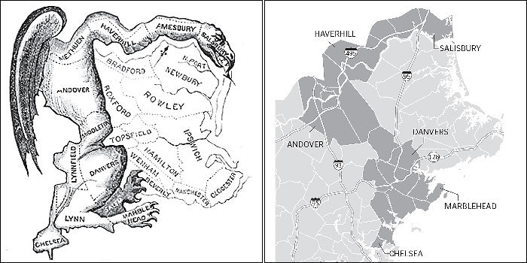
The Districting Problem
Goal: divide counties or states into districts
Objective: Ensure fair representation
Size: equal population
Contiguity: areas within a district
should be connected
Compactness: areas within a
district should be close together
Origin of Gerrymandering (1812)

Slide 3
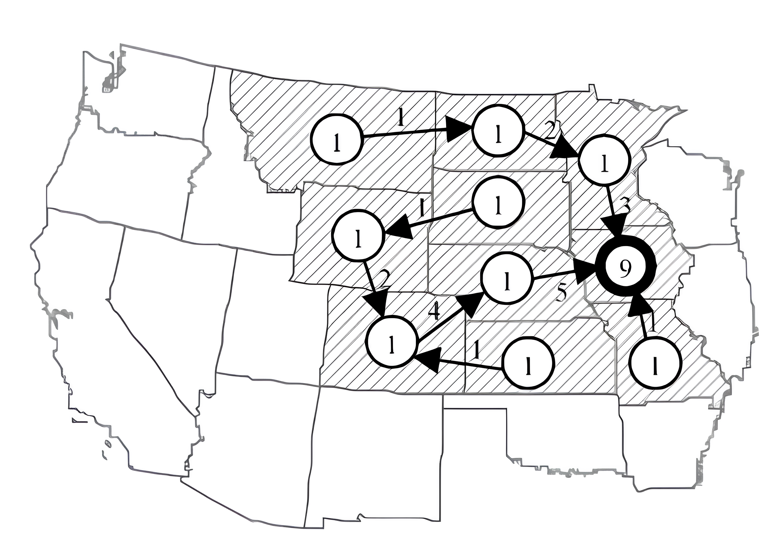
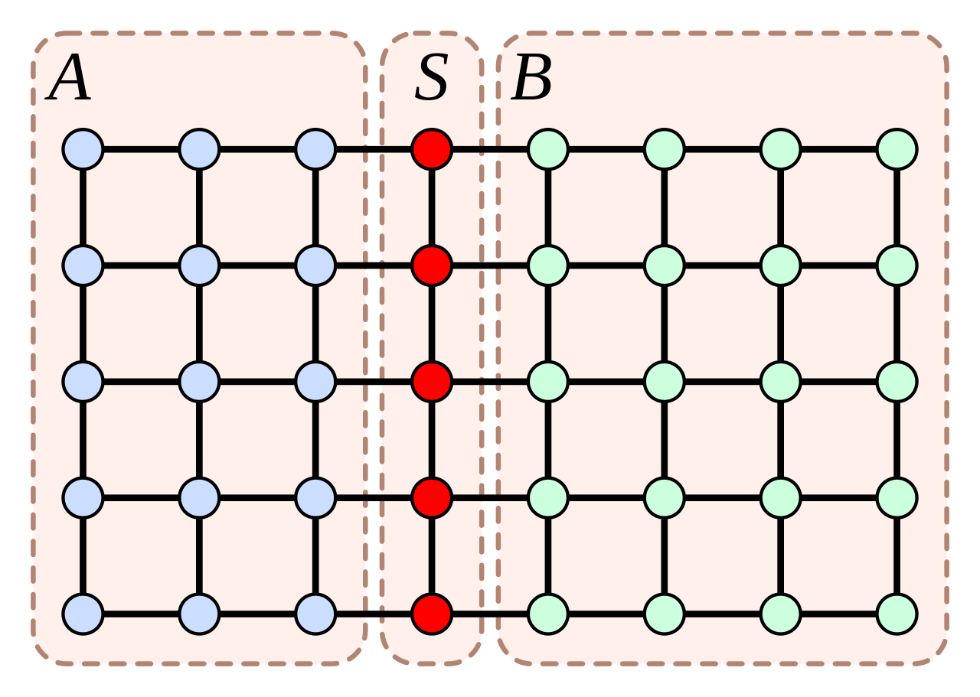
Flow-based algorithms (Shirabe, 2005):
Algorithms from Literature
First use of computers for redistricting in 1964 by Hess et al.
Uses n² binary variables
Solved as warehouse-location problem
Two main algorithms developed:
Cut-based algorithms (Oehrlein, 2017):

Slide 4
Exact Solution

Slide 5
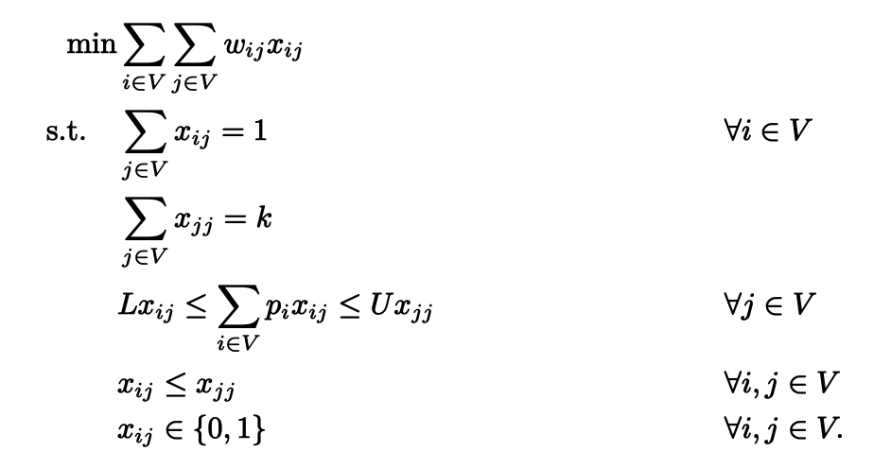
Hess Formulation
Adjacency graph (G = (V, E))
vertex: territory
edge: connection between neighboring territories
Number of districts k
Population of the territories
Distance between territories
Minimum and maximum population allowed in a district (L and U), manually defined

Slide 6
Hess Formulation
Penalty = population * distance^2
1 if vertex i is assigned to the district centered at vertex j
Moment of Inertia
Both population density and geographic distance are being considered when subdividing districts

Slide 7
Hess Formulation
Penalty = population * distance^2
1 if vertex i is assigned to the district centered at vertex j
Each vertex assigned to a district
K districts are chosen
population of each district lies between L and U

Slide 8
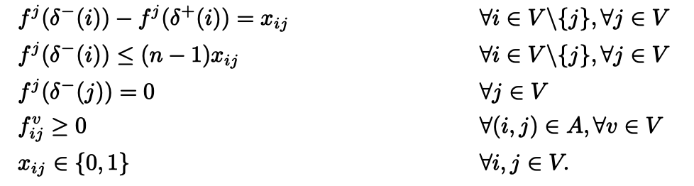
Imposing Contiguity
With Hess model we have to manually adjust solutions to make them contiguous
Oehrlein and Haunert flow-based formulation to enforce contiguity
Amount of flow, originating at district center j, that is sent across edges pointing towards vertex i
if vertex i is assigned to center j, then i consumes one unit of flow of type j
vertex i can receive flow of type j only if i is assigned to center j
prevent flow circulations
Flow is non-negative

Slide 9
Heuristics

Slide 10
Initial Solution
Seed nodes are selected randomly
Find all nodes that are adjacent to the current district and have not been assigned yet
If there are any assign them to the district
End when all nodes are assigned to a district

Slide 11
Objective Function
Population Score
Define max and min range for population
Penalize heavily if the population outside of desired range
Smaller penalty if within the range
Normalize the score
Compactness Score
Calculate the pairwise distances for all nodes within each district
Invert the score so that lower scores are better
Combine both scores into one objective function:
Objective Function = 2 * Population Score + Compactness Score

Slide 12
Get Neighbor
Pick two districts at random
Find border nodes eligible for swapping
Check if population balance improved
Perform swap if population is closer to the desired one
If the connectivity has not been broken return new better solution

Slide 13
Simulated Annealing
Generate neighboring solution
If new score is lower than the current one
If it is not accept it or decline it with the probability of: e^((current_objective - neighbor_objective) / temperature)
Cool down by lowering the temperature value
Check the connectivity of the final solution

Slide 14
Results

Slide 15
Experimental Setup
The investigation was done on seven different states - Alaska (AK), Rhode Island (RI), Washington (WA), Mississippi (MS), Iowa (IA), Idaho (ID), Kansas (KS).
Three unique threshold values were investigated - 10%, 20% and 50%.

Slide 16
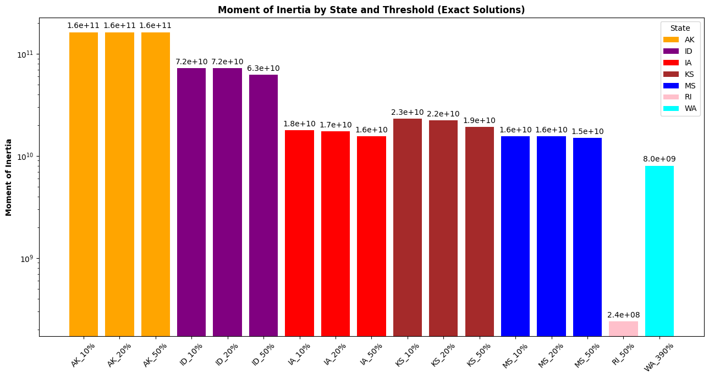
Exact Model Results

Slide 17
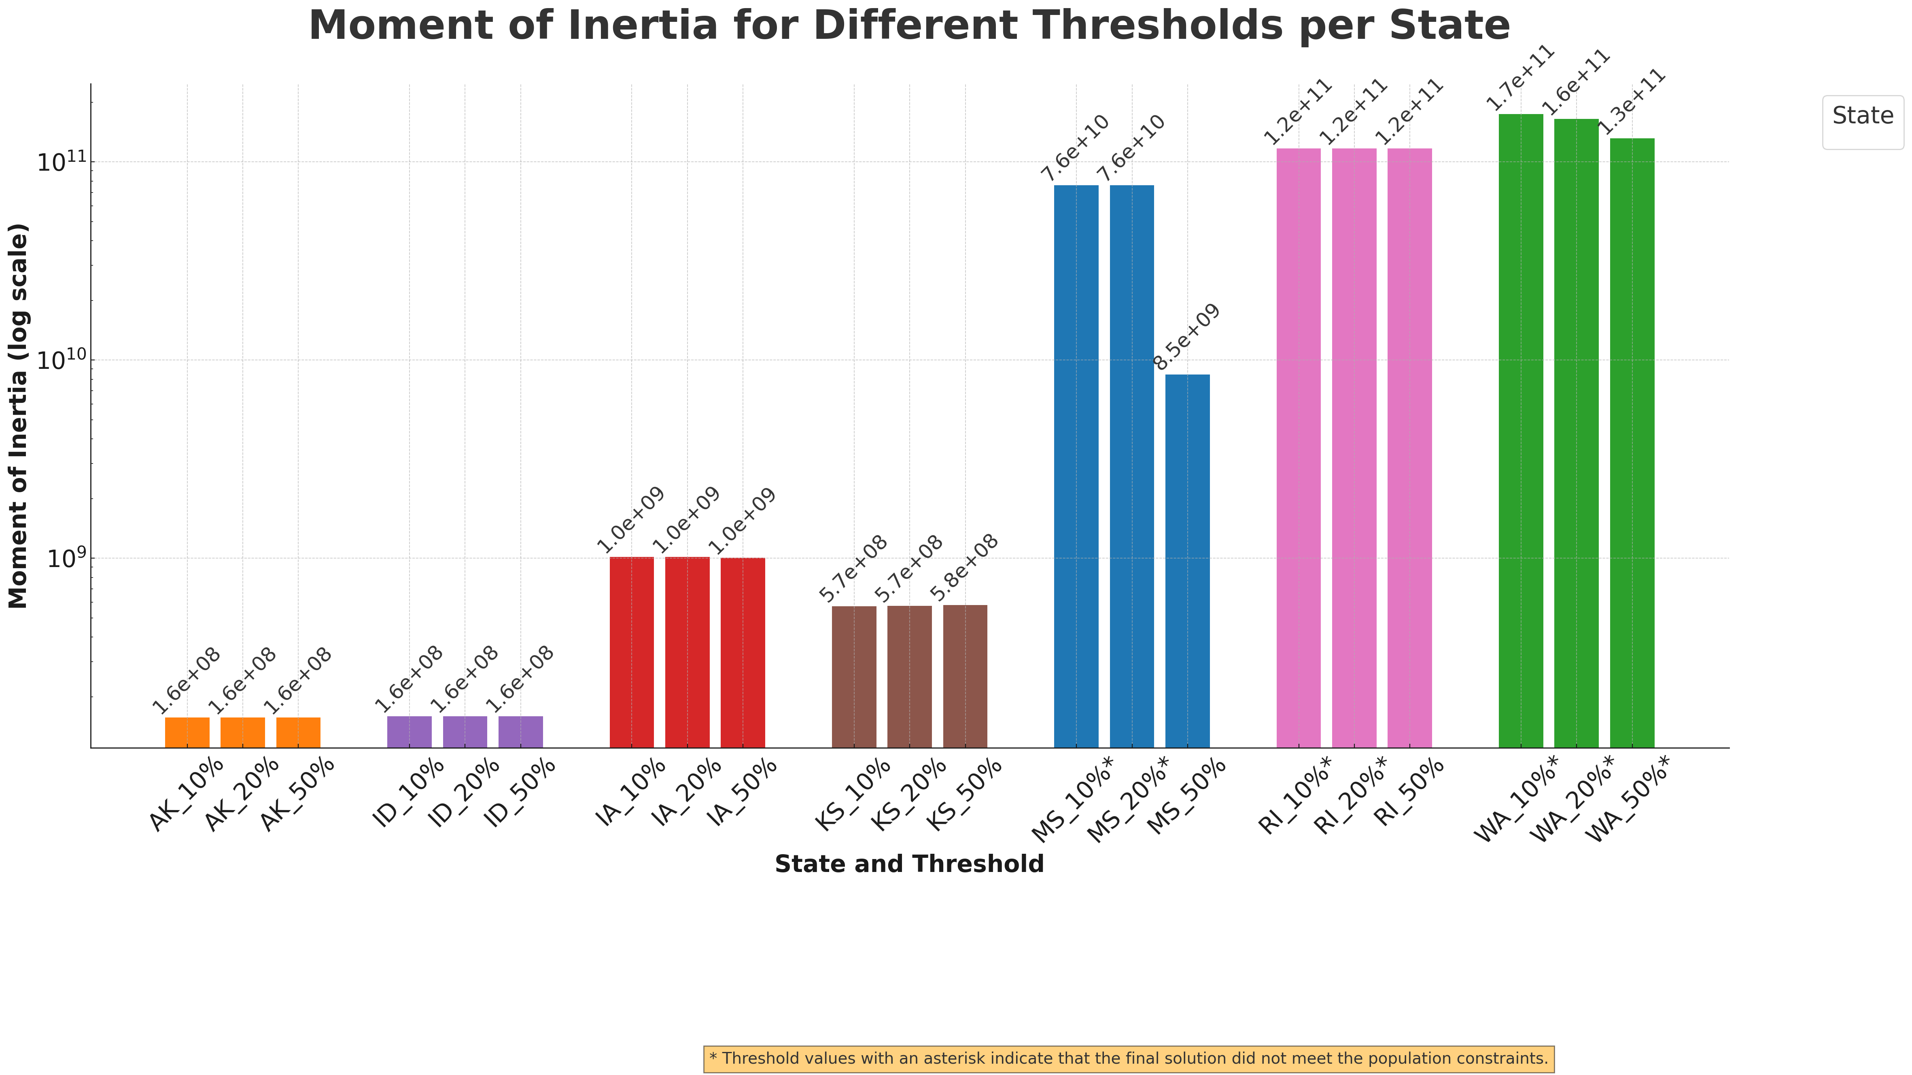
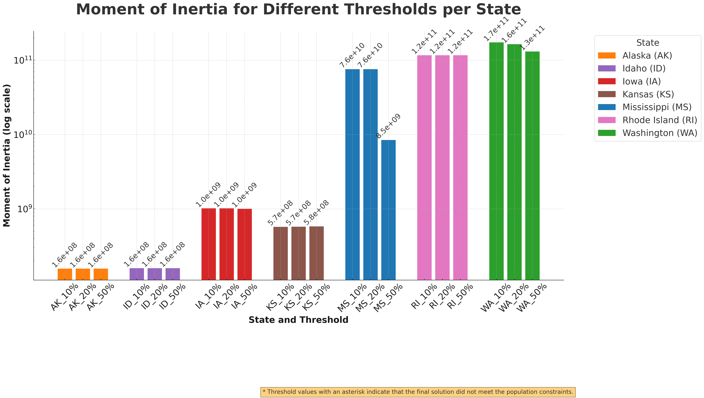
Heuristics Model Results
State | # of Counties (n) | # of Districts (k)
Alaska (AK) | 177 | 1
Idaho (ID) | 44 | 2
Iowa (IA) | 99 | 4
Kansas (KS) | 105 | 4
Mississippi (MS) | 82 | 4
Rhode Island (RI) | 5 | 2
Washington (WA) | 39 | 10
*Threshold values with an asterisk indicate that the final solution did not meet the population constraints

